Slide 1
CZ 3003 Software Systems Analysis and Design
Presentation of Crisis Management System by team 8Pax

Slide 2
Product Scope
The Crisis Management System(CMS) is designed with the intent to send out important information regarding hazardous incidents to the general public and relevant departments

Slide 3
What should it do?
Users make reports regarding incidents that occur at their location i.e. fires, epidemic, accidents
Reports will be sent to the Call Centre and from there, the information is sent to the corresponding departments
Subscribers of the CMS social media, SMS list will be notified about the updates on the incidents that are in their Area

Slide 4
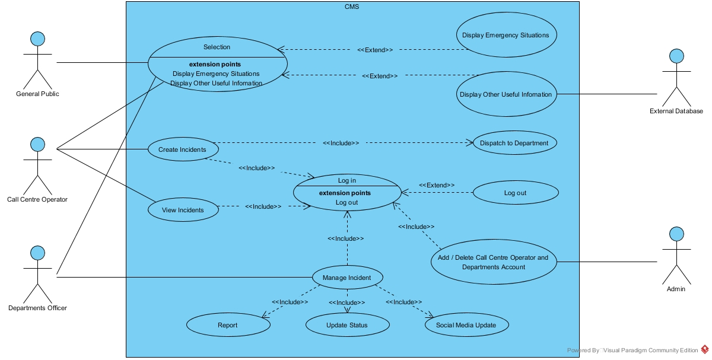
How it should work

Slide 5
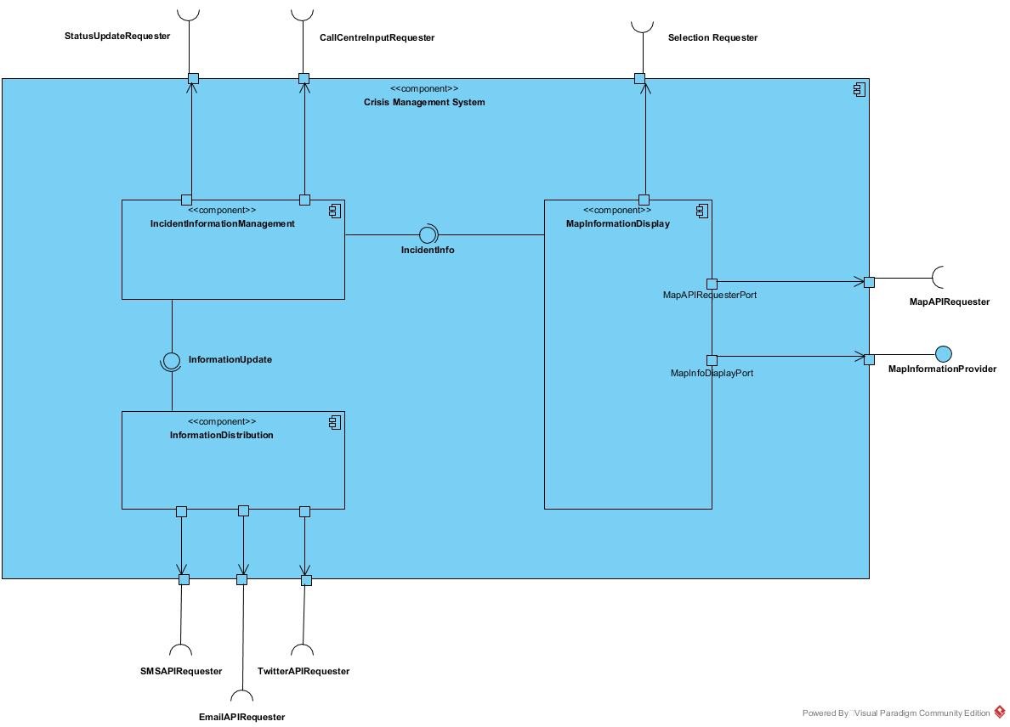
Overall CMS System

Slide 6
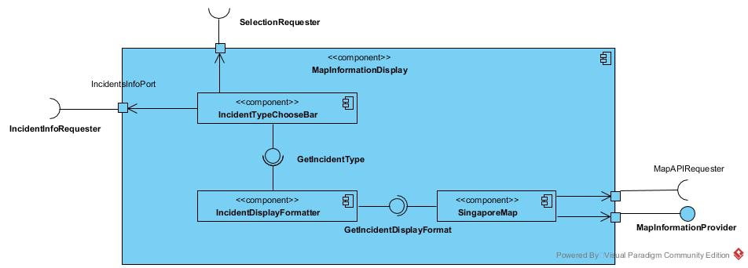
Subsystem 1: Map Information Display

Slide 7
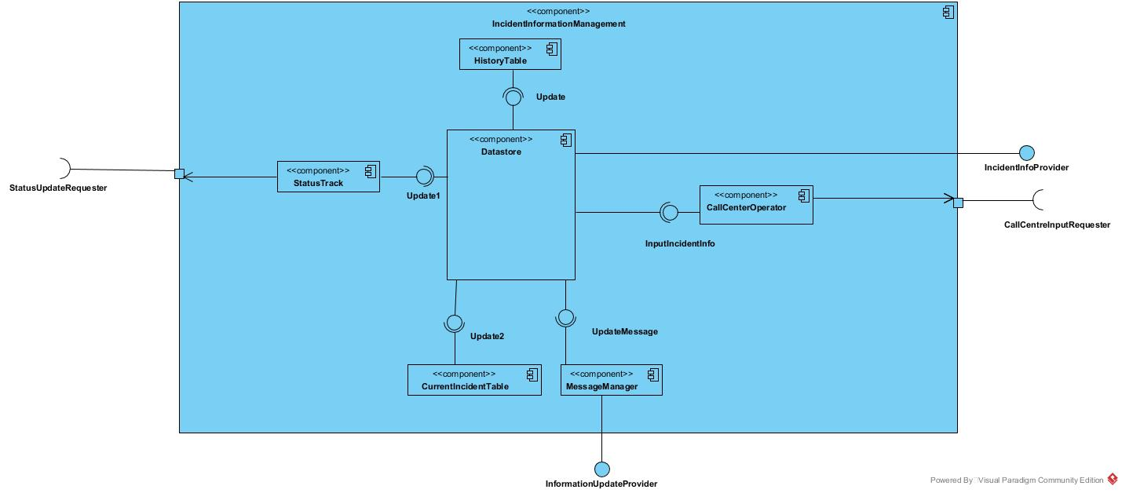
Subsystem 2: Incident Information Management

Slide 8
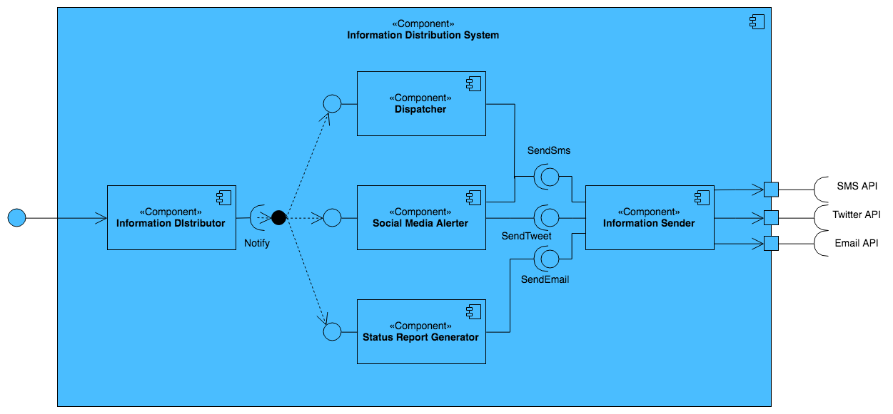
Subsystem 3: Information Distribution

Slide 9
Architecture Rationale
Low coupling, high cohesion
Data flow and implicit invocation
Reliability
Flexibility
Reusability

Slide 10
Django Web Framework
Security: Django ensured that developers don’t commit any mistakes related to security. Some of the common mistakes include SQL injection, cross-site request forgery, clickjacking and cross-site scripting. Django adopts the authentication system to manage effectively usernames and passwords.
Scalability: To meet the heaviest traffic demand, the benefits of Django framework can be seen. Therefore, the busiest sites use this medium to quickly meet the traffic demands.
Versatility: Content management, scientific computing platforms, and even big organizations, all these aspects are very efficiently managed by the use of Django.

